Slide 1

Factor-Based Fund Analysis & Portfolio Modeling
Team 11: Jesse Kinsmann, Yangze Li, Shon Shaju, Kai Tran

Slide 2
Table of contents
01
02
03
Problem
Statement
Dataset
Overview
Exploratory Data Analysis
04
05
06
07
Data
Cleaning
Utility Function
ML
Model
Recommendations and Limitations

Slide 3

01
Problem
Statement

Slide 4
Problem Statement
With many mutual funds and ETFs, investors face decision overload and often rely only on past returns
Problems
Risk Blindness: Investors overlook volatility and downside risk
Fee Neglect: Fees quietly erode returns over time
Poor Diversification: Chasing winners leads to concentrated portfolios
Short-Term Bias: Investors overweight recent performance
Motivation → Build a framework that integrates risk, fees, diversification, and performance to match investors’ preference
Notes:
Our motivation is to address these challenges by building a framework that integrates risk, fees, diversification, and performance.

Slide 5

02
Dataset
Overview

Slide 6

Dataset Summary
Data Source
Time Horizon
Scale & Coverage
U.S. Mutual Funds and ETFs dataset from Yahoo Finance
Historical daily prices
Data up to Nov 2021
Mutual Funds: 23,783 funds, 298 attributes
ETFs: 2,310 funds, 142 attributes
ETF Price Records: 3,866,030 daily observations

Slide 7
Key Attributes
Fund-Level Attributes
Category, family, asset class
Expense ratio, turnover
AUM, share class
Management style
Performance Metrics
1Y / 3Y / 5Y returns
Volatility
Sharpe ratio
Beta
Drawdowns
Price Data
Open, high, low, close
Adjusted close
Volume
Notes:
More icons

Slide 8

Exploratory Data Analysis
03

Slide 9
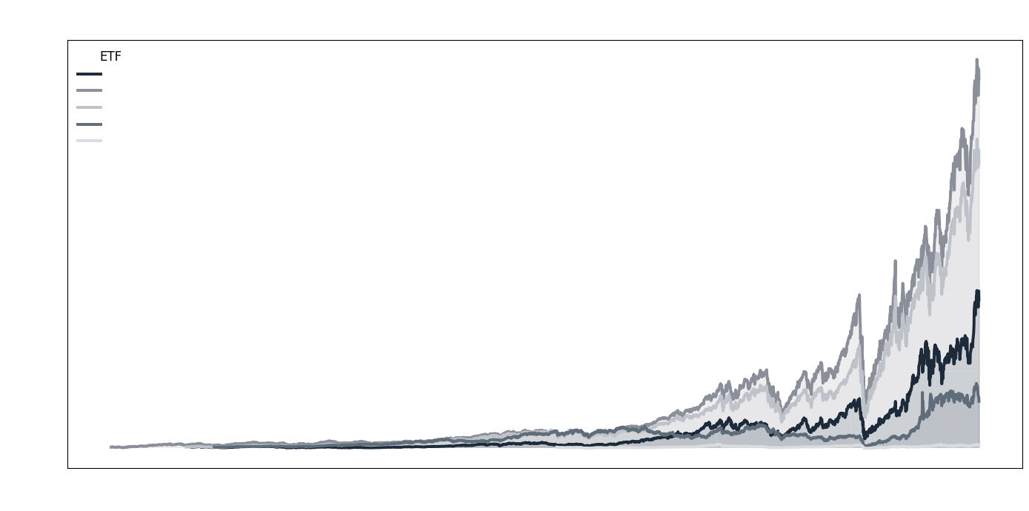
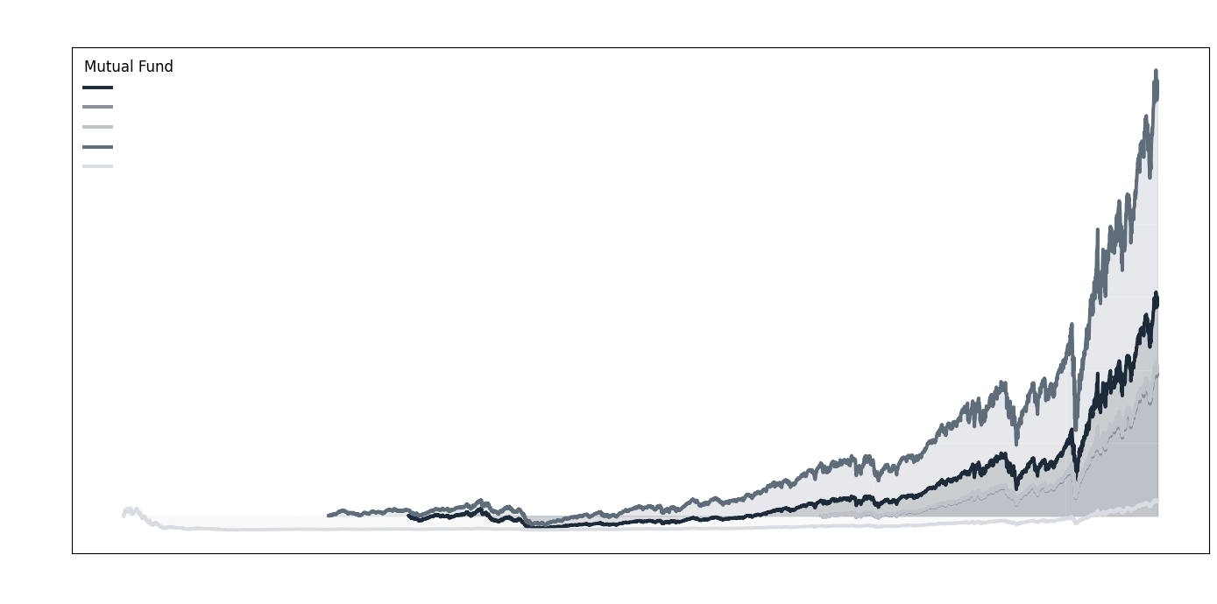
ETFs Outperform Mutual Funds Over Time
ETFs deliver better cumulative returns, with top reaching 15,000%–25,000%+ vs 2,000–3,000% for the best mutual funds
Leveraged and sector ETFs (e.g., SOXL, TECL, TQQQ) show long-term growth, especially during tech-driven bull markets.
Mutual funds demonstrate steadier, more conservative growth

Slide 10
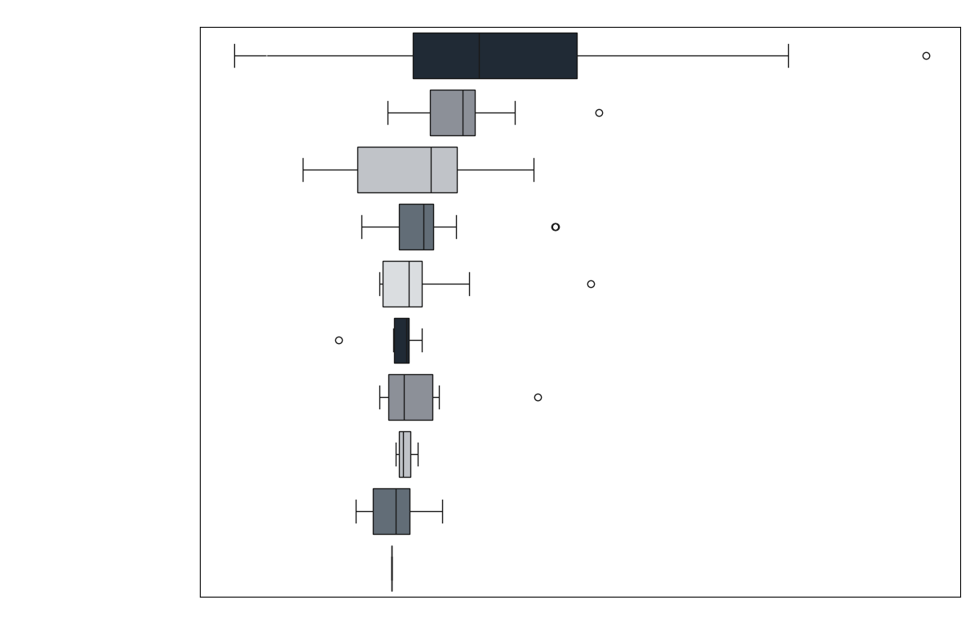
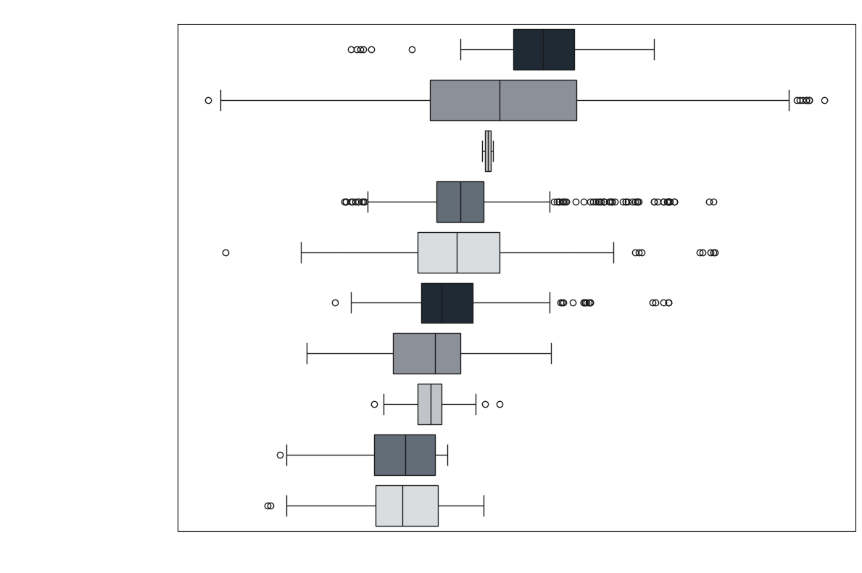
Higher Growth Potential in ETF Categories
ETFs outperform mutual funds across nearly every top category, both in median return and upper-range potential
Technology and Growth categories dominate for both ETFs and MFs, but ETFs deliver significantly higher returns in these areas
The distribution shapes show ETFs are better suited for aggressive growth, while mutual funds offer stability and lower volatility

Slide 11
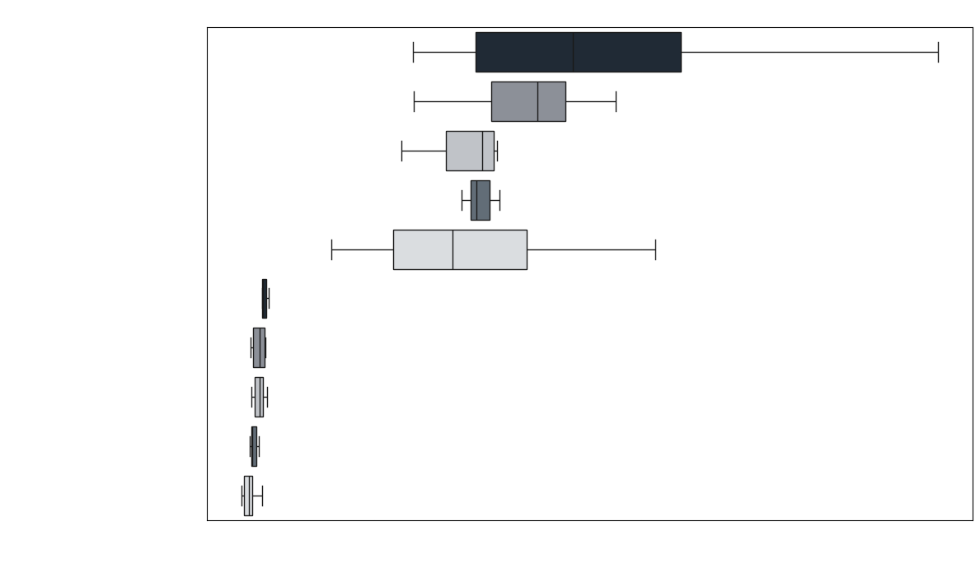
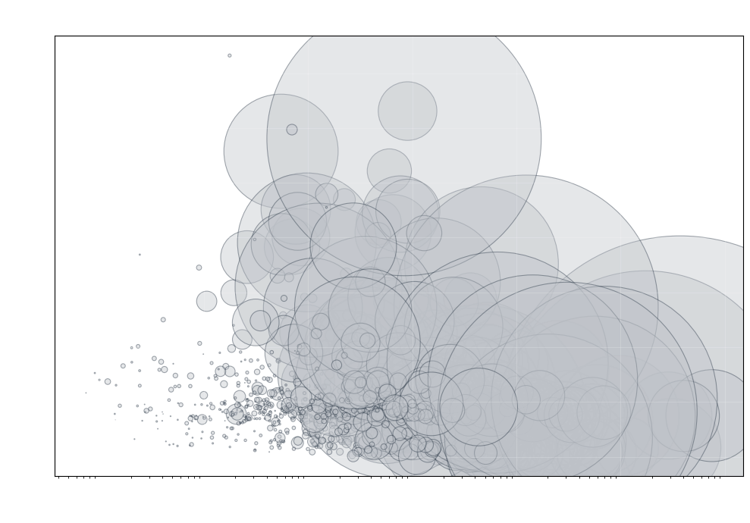
ETFs Exhibit Higher Volatility but Stronger Market Liquidity
Trading & leveraged ETFs are the most volatile, while Bond and diversified equity ETFs are the least volatile
Larger ETFs (higher AUM) tend to cluster toward the lower-volatility region
Small-AUM ETFs show widely dispersed volatility

Slide 12
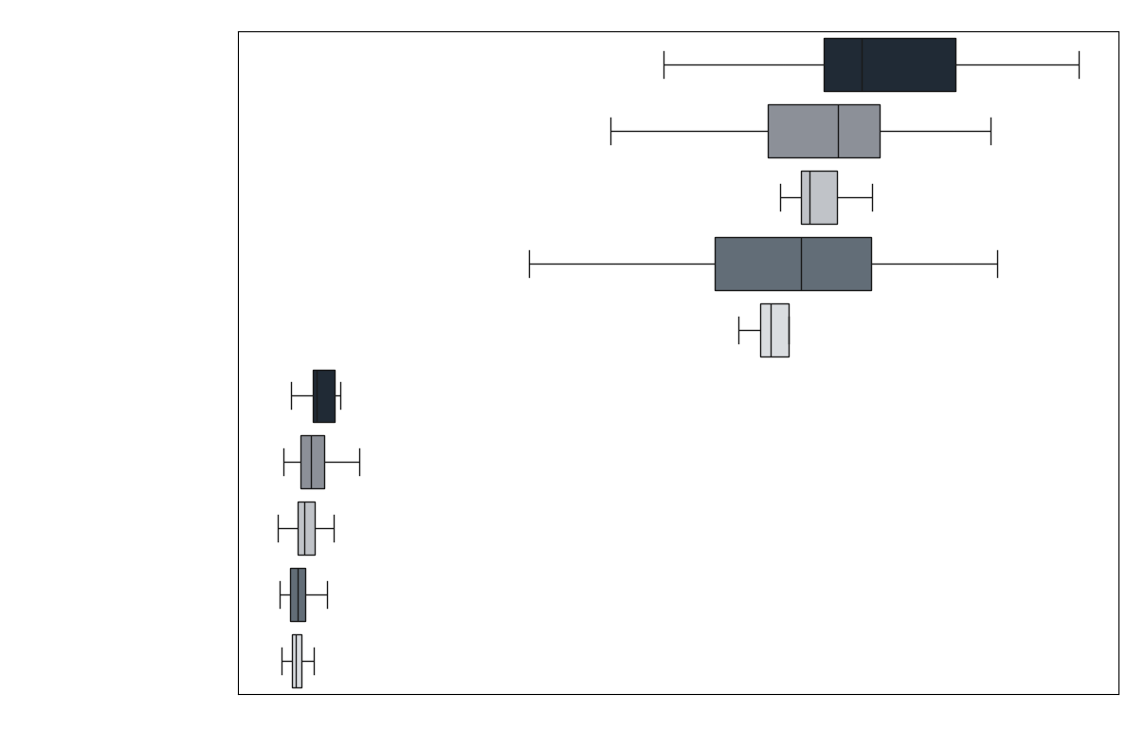
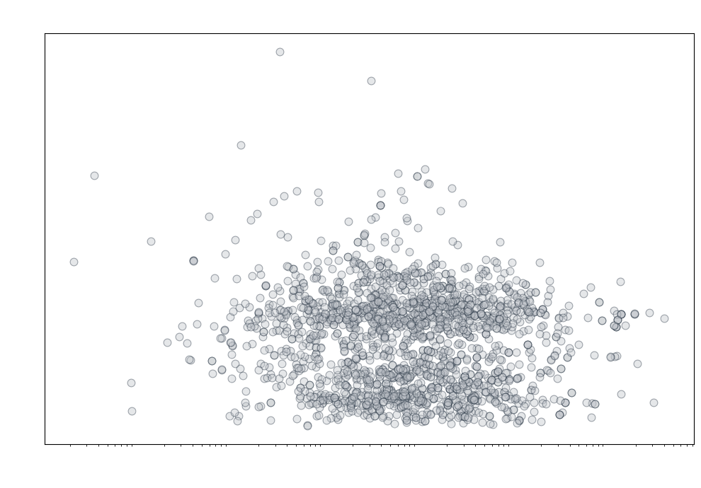
Mutual Funds Show Lower Volatility and More Stability at Larger AUM
Mutual funds exhibit significantly lower volatility than ETFs
High-volatility mutual fund categories are far fewer and generally tied to emerging markets
Bond-heavy and diversified mutual funds show the lowest risk

Slide 13
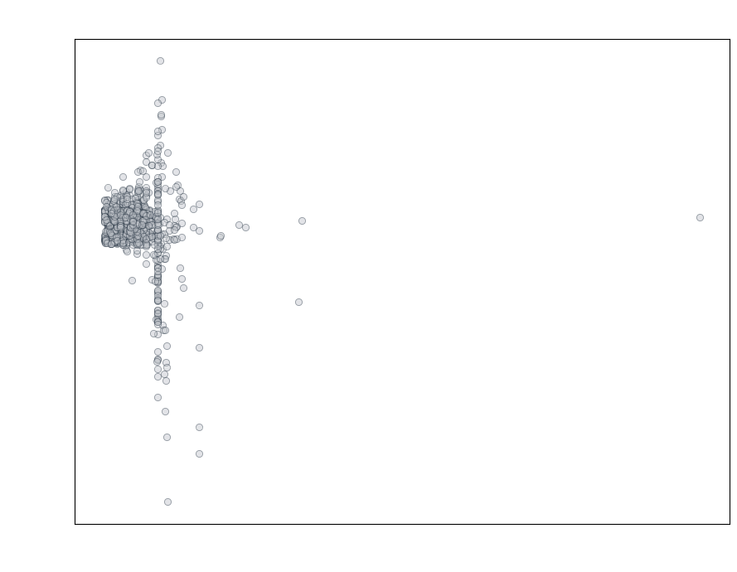
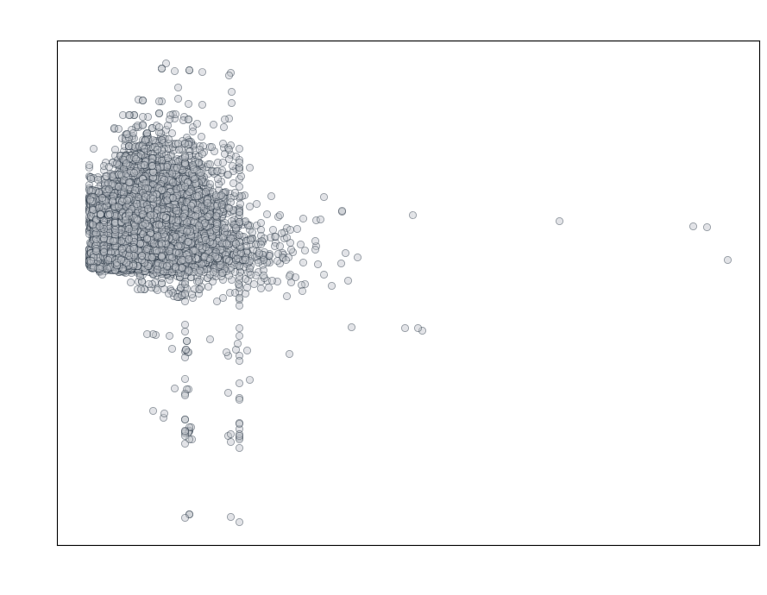
Expense Ratios Show Weak Relationship With Performance
Most ETFs cluster at very low expense ratios (0.00–0.02)
Mutual funds exhibit a wider spread of expense ratios (0.00–0.12)
Mutual funds have higher fees but lower and more compressed returns than ETFs

Slide 14

04
DATA CLEANING

Slide 15
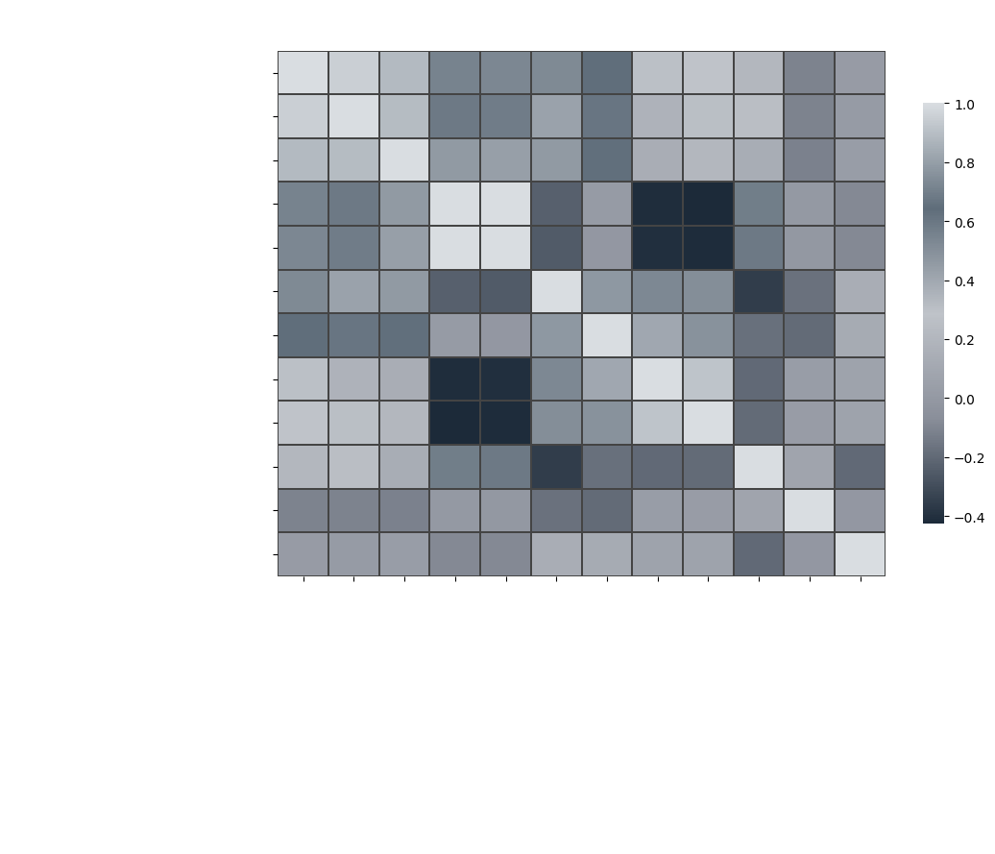
Correlation Matrix Analysis
Narrowed down to a final set of key performance drivers—returns (1/3/5/10Y), volatility, Sharpe ratios, alpha, fees, turnover, and fund size
Correlation matrix to validate our feature choices; correlations were moderate and non-redundant
Outliers, missing values, and inconsistent records were removed.

Slide 16

Synthetic Investor Profiles
Problem
Solution
Our model needs investor–fund pairs (who you are × which ETF/MF) to learn a personalized utility score
Don’t have thousands of survey responses on preferences
Without enough profiles, the model could become biased toward a narrow type of investor and miss important segments
Create 800 synthetic investors using controlled random sampling
Each investor is described by four key attributes:
Risk tolerance: low, medium, high
Investment horizon: 3, 5, 10 years
Income level: low, medium, high
Active preference: active, passive, either
Probabilities are tilted to look realistic (e.g., more medium-income, medium-risk investors than high-risk/high-income)
Risk tolerance: Low
IV horizon: 3 years
Income level: Low
Active preference: Passive
John Doe

Slide 17

Utility Function
05

Slide 18
Utility Score =
2.0(Return Score) + 1.0(Alpha Score) + 1.5(Sharpe Score) + 1.0(Liquidity Score) + 0.8(Active Match) − 2.5(Risk Mismatch) − 1.5(1−Fee Score) − 1.0(Load Penalty) − 1.0(Tax Penalty)

Slide 19
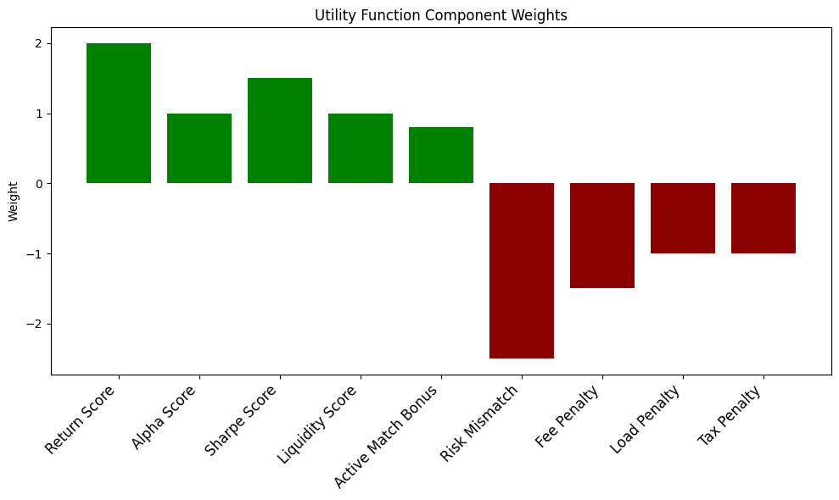
How does a Fund fit your needs?
Increases Utility Score
Return percentile
Alpha score
Sharpe score
Fund Liquidity Score
Investor active preference
Decreases Utility Score
Risk mismatch
Fees
Expense ratio
Turnover rate

Slide 20

ML
Model
06

Slide 21

XGBoost Regressor predicting match scores for each fund based on investor’s preferences.
Input: Investor Details
Risk Tolerance & Income Level (Low, Medium, High)
Investment Timeline (3, 5, 10 years)
Active Preference (active, passive, either)
Logic
Utility Scoring System
Generate Synthetic Investors
Compute Fund Performance & Costs Features
One-hot encode Categorical Attributes
Normalize Numerical Attributes
Final Utility Regression RMSE: 0.1092

Slide 22
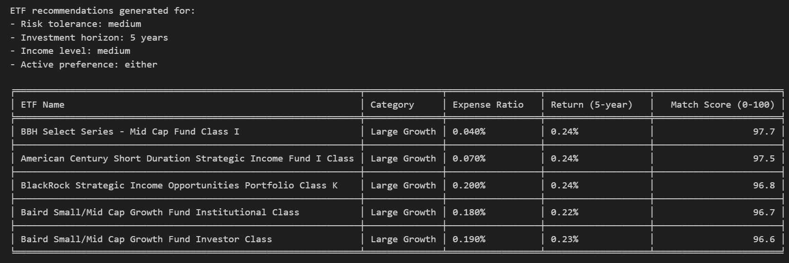
ETF Example Output

Slide 23
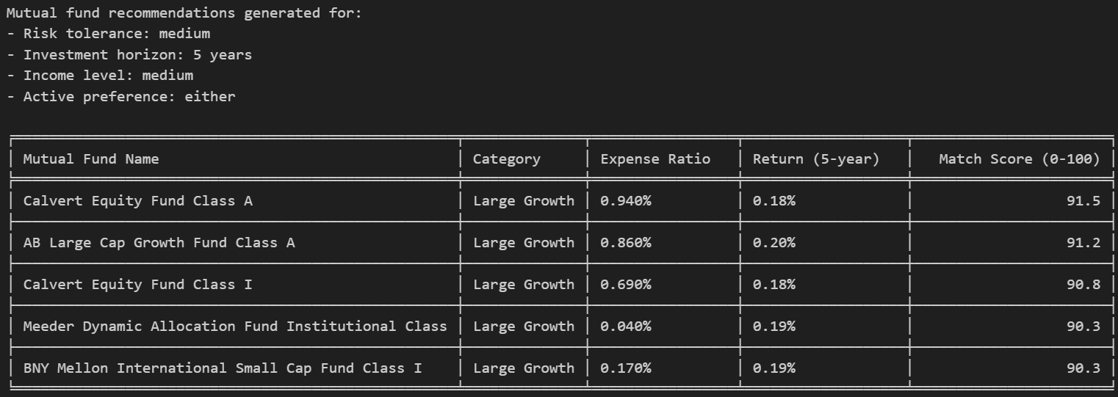
Mutual Fund Example Output

Slide 24

Why XGBoost?
Handles Nonlinear Investor/Fund Relationships
Naturally Learns Models Interactions
Performance with Tabular Data
Optimized for Large Data
Linear Models cannot learn interactions like risk tolerance * volatility
Learns interactions without manual feature engineering
Lower RMSE, Higher Stability, Better accuracy than other models
Handles missing values and Parallel data training increasing speed

Slide 25

Recommendations & Limitations
07

Slide 26
Next Steps
1.
Adopt a hybrid decision strategy
2.
Prioritize low-cost ETFs for investors
3.
Re-train the model with new fund data
Create a combined ranked list (Top 10 funds/ETFs)
ETFs tend to perform better on net-of-fee basis
Periodically update returns, fees, liquidity

Slide 27
Limitations
Limited Factor in Utility Functions
Assumed Investor Weights
Generalizability
Omitting drivers such as macroeconomic cycles, ESG screens, tax considerations
Model reflects our assumptions instead of validated behavioral data
ETFs’ lower fees and higher liquidity may cause the model to over-recommend ETFs

Slide 28

Questions?
Thanks,

